Slide 1
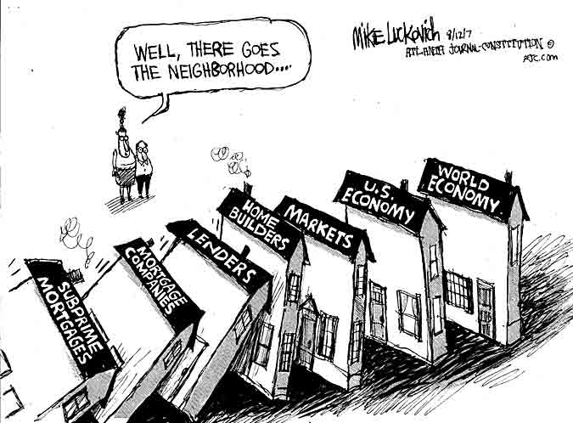
Sandy Lai
SMU http://www.sandylai-research.com
The Role of Equity Funds in the Financial Crisis Propagation
Harald Hau
University of Geneva and SFI
http://www.haraldhau.com
1
Notes:
1

Slide 2
Motivation and Key Findings
Subprime exposure was concentrated in financial stocks which account for only 15% of the US stock market in 2007
How could this lead to a 50% decline of the non-financial stocks?
This paper examine the role of mutual funds as a channel of asset contagions from financial to non-financial stocks
Document that the 30% stocks most exposed (via stock ownership) to distressed funds have an under-performance of 35% at the peak of the crisis
© Harald Hau, University of Geneva and Swiss Finance Institute

Slide 3
Hypotheses
H1: Simple Fire Sale Hypothesis
  Stocks owned by equity funds with high exposure to bank stocks in 2007/2 and 2008/1 face larger selling pressure and show poor crisis performance.
H2: Stock Performance Dependent Fire Sales Hypothesis
Distressed funds sell primarily better performing stocks when in distress
    Valuation Uncertainty makes over-performing stocks better sells
    Disposition Effect
    Tax Effect
H3: Fund Share Stability Hypothesis
Stocks with a large share of (non-distressed) fund owners perform better during the crisis
    Panic sales by direct retail investors
    Self-selection of retail investors into fund and direct investors

Slide 4
Measure Contagion Through Fund Ownership
Fund A
( exposed)
Fund B
(non-exposed)
Bank Stock
Stock 1
Stock 2
Stock 3
Procedure:
  Step 1: Measure fund exposure to financial stocks
  Step 2: Measure stock exposure in non-financials to exposed (distressed) funds

Slide 5
Data
Fund holding data:
  27,274 equity funds in 69 countries
  Reported holding concern approximately 30,000 stocks
After data filtering:
  Work with 20,477 funds
  Report $9,7 trillion in equity assets under management in June 2007

Slide 6
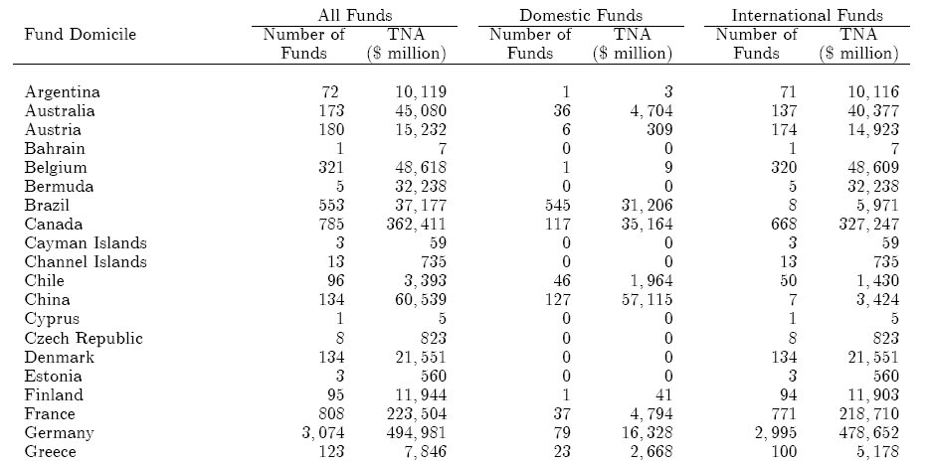
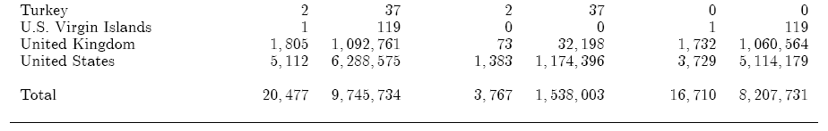
Summary Statistics
[...]
[...]

Slide 7
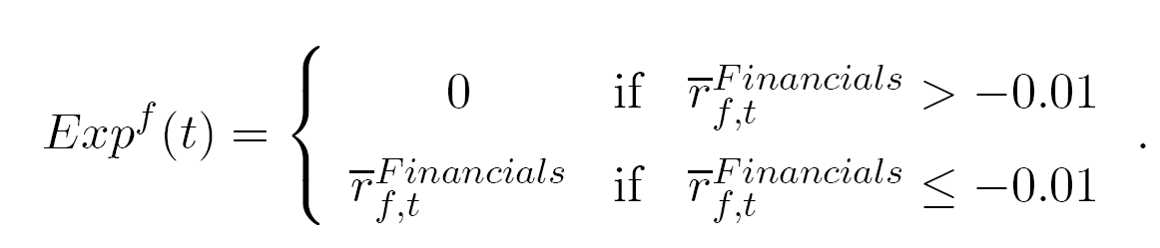
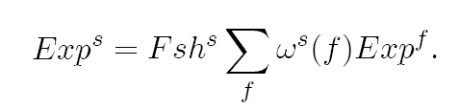
From Fund Exposure to Stock Exposure
Fund exposure: Return loss (if larger than 1%) due to financial stock investments in 2007/2 and 2008/1
Stock exposure: Aggregate fund exposure of all funds holding a stock weighted by fund ownership relative to capitalization

Slide 8
Exposed versus Non-Exposed Stocks
Define exposure dummy DExp for 15% most exposed stocks worldwide
We find that exposed stocks
  are concentrated in the U.S. market (30%)
  are spread over all industries
  are on average larger than non-exposed stocks
  show a drastic reduction of their fund holdings relative to non-exposed stocks
No evidence that exposed funds are different
  Same average pre-crisis return on assets

Slide 9
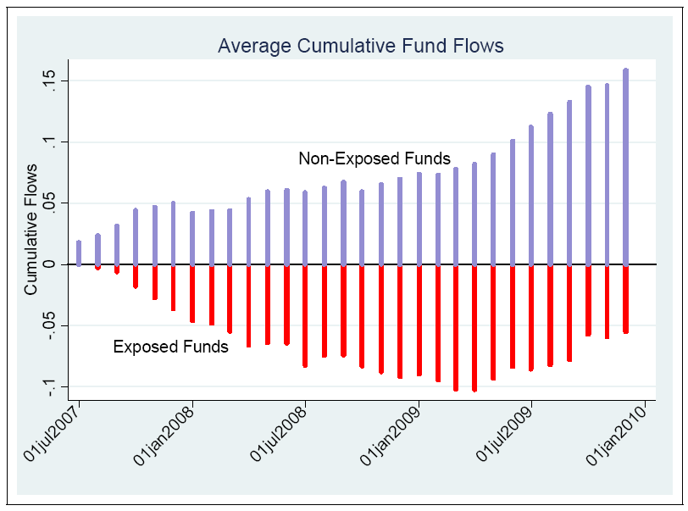
Fund Redemption

Slide 10
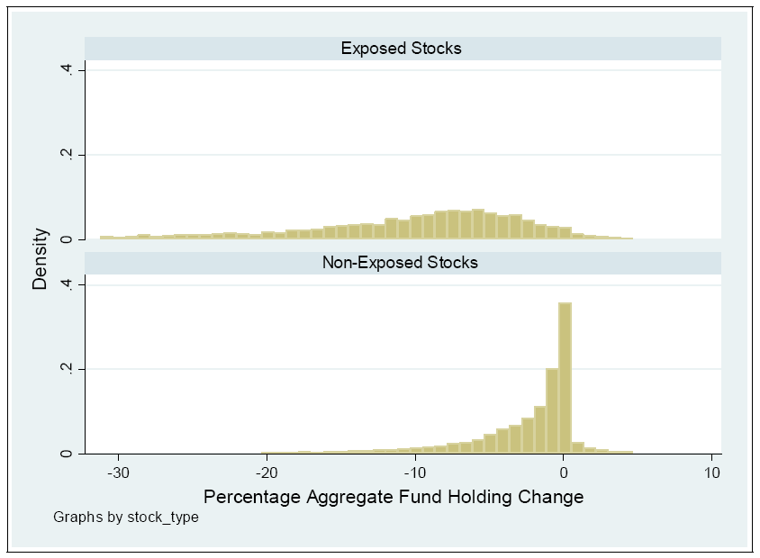
Fund Holding Changes During Crisis
Fire Sale Effect:
Large percentage holding reduction!

Slide 11

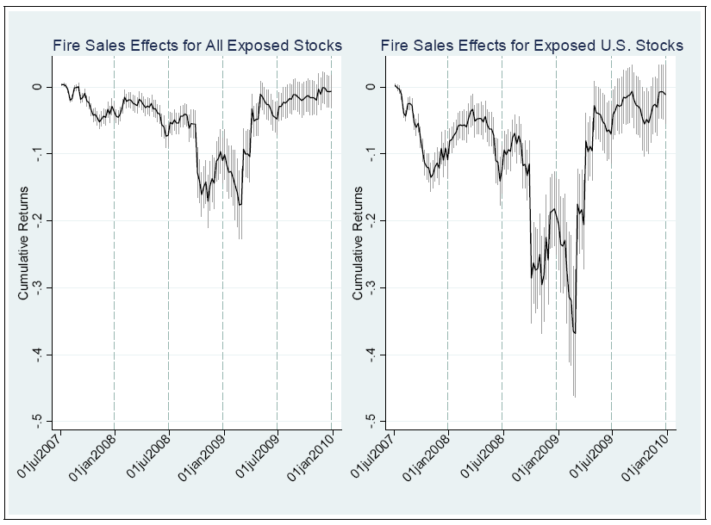
Relative Underperformance of Exposed Stocks
Feb 27, 2009:
-35%

Slide 12
H1: Evidence on Fire Sale Hypothesis
Stocks owned by distressed funds dramatically underperform during the crisis relative to industry peers
  Return shortfall of 35% on February 27, 2009 for the 30% most exposed U.S. Stocks
  Also large effects for non-U.S. stocks
  Fire sale discounts are transitory
Contagion channel through fund ownership can account for at least 10% of the downturn in non-financial stocks

Slide 13
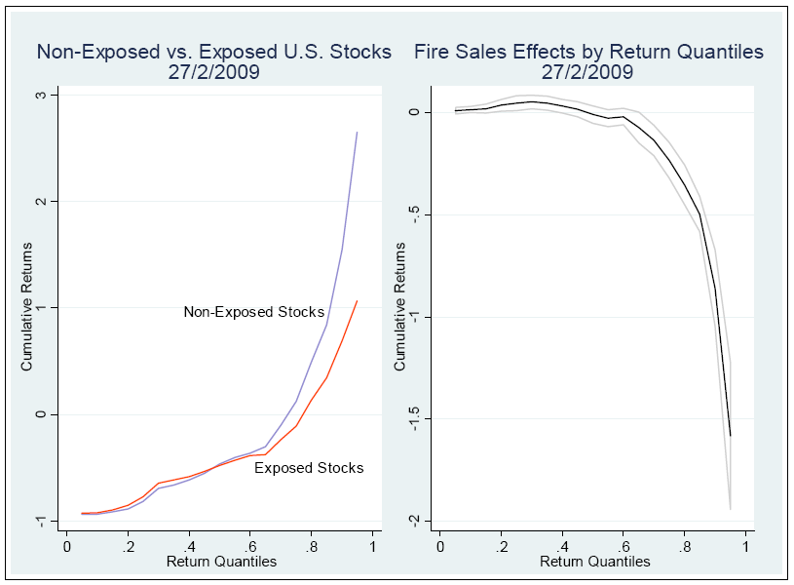
H2: Stock Performance Dependent Fire Sales?

Slide 14
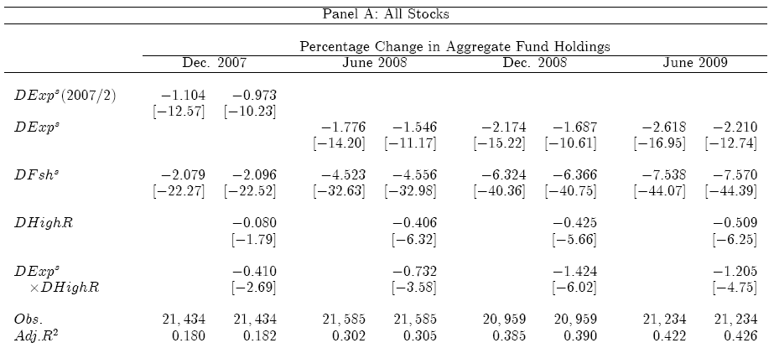
Matching Evidence on Holding Changes
Additional Holding Reduction by
Exposed Stocks
Additional Holding Reduction by
25% Best Performing Exposed Stocks

Slide 15
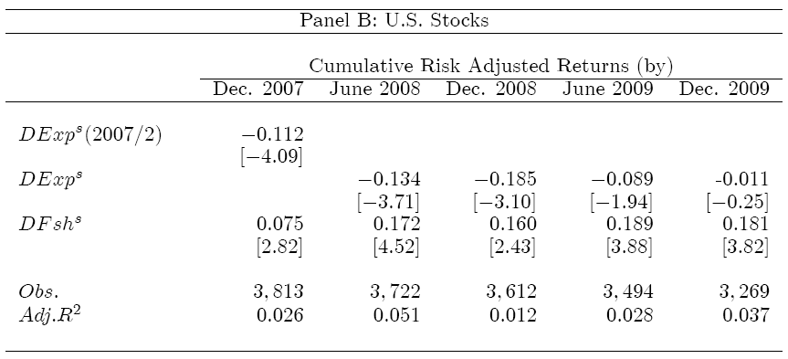
H3: Are Stocks with high Fund Share more stable?

Slide 16


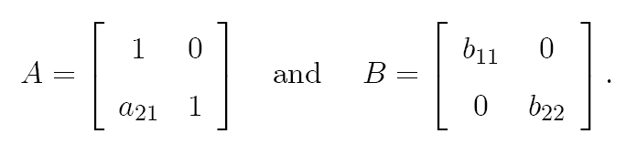
Are Direct Investors more Panic-Prone?
Retail investors with direct investments might be more prone to panic than those investing through mutual funds; hence a high fund share increases a stock’s crisis resilience
Fund ownership share and NYSE retail trading volume have correlation of - 0.58
Define two long-short portfolio loading on stocks with
(i) high direct ownership share (DMF = direct minus fund)
(ii) high retail trading (RMI = retail minus institutional)
VAR structure:

Slide 17
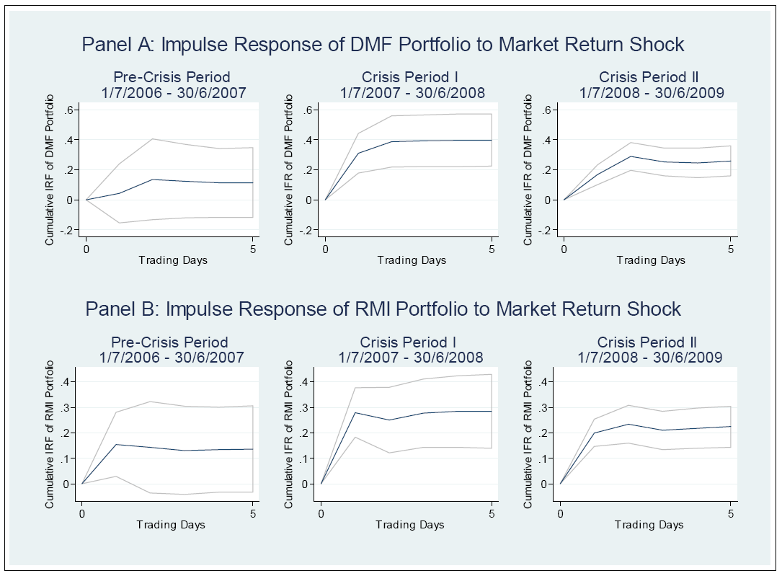
Impulse Response to Index Return Shock
(DMF = Direct minus Fund RMI = Retail minus Institutional)

Slide 18
Summary of VAR Evidence
Evidence of Granger causality from index returns to the DMF portfolio return
Find Granger Causality during the two crisis periods, but not before the crisis
Spill-over occurs (mostly) with a one-day lag
It is economically large: A 1% index shock causes a DMF return of 0.41% for the DMF portfolio

Slide 19
Summary of Findings
Equity funds were a very important channel for asset contagion from bank stocks to non-financial stocks
Paradoxically, fire sales are concentrated in the best performing stocks
(Non-distressed) fund ownership increases a stock’s crisis resilience
Evidence of more “flight to quality” (retail investor panic) among direct than indirect (fund) investors

Slide 20
Implications for Fund Management
Information Management
  Ownership data becomes more widely available
  Keep updated information on ownership linkages
Arbitrage Strategies
  Distressed selling can give rise to large return premia
  Retail investment biases create differential crisis sensitivity
  Retail investor related mispricing (Peress and Fang, JF 2009)
Risk Management
  Retail ownership is an important stock characteristic capturing additional event/crisis exposure

