Slide 1
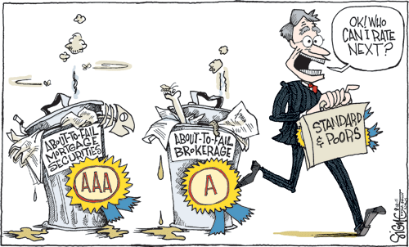
Bank ratings:
What determines their quality?
Harald Hau
University of Geneva and SFI
http://www.haraldhau.com
Sam Langfield
ESRB
David Marques-Ibanez
European Central Bank

Slide 2
Why look at bank ratings?
Annual issuance in Europe: USD600 billion of unsecured bank debt
Spectacular rating failures in the 2007–08 crisis expression of a general problem?
Cornerstone of bank regulation, determine capital requirements for interbank exposure
Ratings set investability thresholds for many institutional investors (segment markets)

Slide 3
Literature
Bank rating inherently difficult:
  Opacity of banks, increased complexity: Rating disagreement more frequent for banks (Morgan, 2002)
  Bank business model should matter for rating quality
  Rating agencies may find it too costly to produce high quality bank ratings
Conflicts of interest:
  “Issuer pays model” may lead to complacent ratings (Pagano and Volpin, 2010; White, 2010)
  Rated firm can “shop for better ratings”
  Rating agencies can undertake unsolicited ratings
  Buy side is misled by flawed ratings
Buy side collusion with issuers and rating agencies
  Capital requirements and investability conditioned on ratings
  Rating inflation is a collusion with buy side to evade regulatory requirements (Calomiris, 2009; Efing, 2012)
  Why were so many ABSs on bank balance sheets?

Slide 4
How to measure credit rating (CR) quality?
Our measure of bank distress:
EDF: Expected default frequency
Use KMV data from Moody’s
Obtained from a structural model predicting default once the bank asset value hits a default boundary
Rating quality: How well do bank ratings predict expected default frequencies two years later?

Slide 5
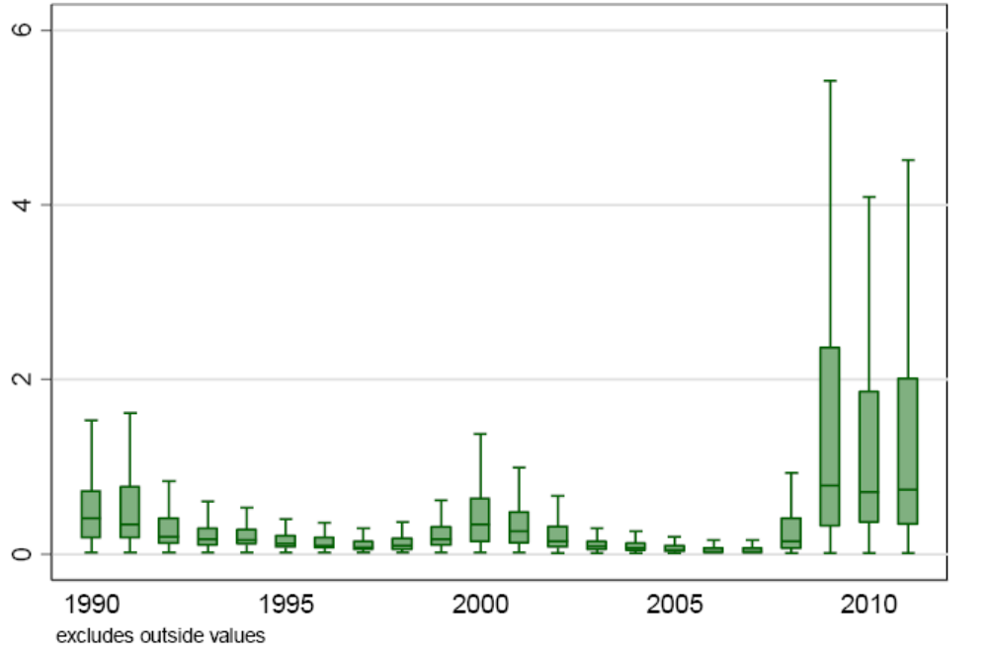
Expected default frequencies (EFDs)

Slide 6
EDF data features
EDFs’ distribution dramatically changes in crisis
Interpretation of credit ratings:
  Cardinal: CRs correspond to absolute EDF –> ratings need to forecast the crisis
  Ordinal: CRs provide ranking of EDFs
  –> only judge relative rating quality or rating consistency
Ordinal approach is the weaker standard:
  Error defined as the non-parametric difference of the EDF ranking and CR ranking

Slide 7
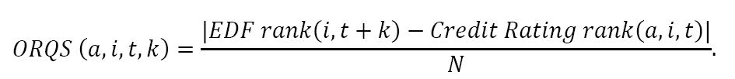
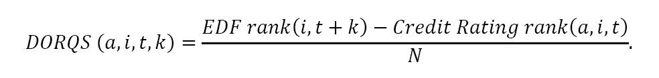
Rating error as rank change
Perfect Rating: Ordering of bank CR corresponds perfectly to ordering of future EDFs
Arbitrary Rating: No relationship between CR rank and future EDF rank
Non-Directional Error (ORQS)
Directional Error (DORQS)

Slide 8
How to measure rating error?
High rating quality:
  CR rank and EDF rank are strongly related
  Scattered along the 45 degree line in a CR-rank EDF rank plot
Low rating quality:
  CR rank and EDF rank shows no correlation
  Uniform distribution in the CR rank – EDF rank plot

Slide 9
Bank rating data
End quarter bank rating data from Moody’s, S&P and Fitch for 1990-2011 on 369 banks headquartered in the US and EU15; ignore subsidiary ratings
  Uniform rating scale across agencies
  Further subdivide each grade by rating outlook (if possible)
Use EDF data from Moody’s (measured two years later)
  EDF calculations are based on the Merton model
  Drawing on Moody’s data spares us any parameter choices
Obtain 21,131 ORQS observations; 75% fall into 2000-2011

Slide 10
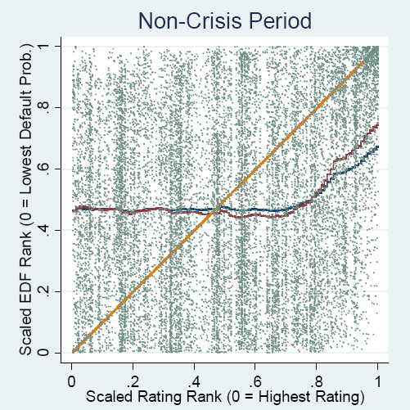
Credit rating rank and EDF rank
Uniform distribution in the investment grade range (AAA to BBB-)
Correlation only for speculation rating range (BB+ to C)
The ORQS is distance from the 45 degree line
Credit Assessment | AAA to AA- | A+ to A- | BBB+ to BBB- | BB+ to B- | Below B- | unrated
Risk Weight | 20% | 50% | 100% | 100% | 150% | 100%

Slide 11
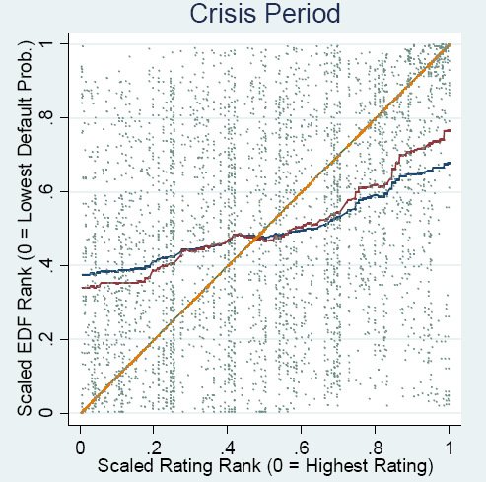
Credit rating rank and EDF rank
Weak correlation between rating rank and EDF rank also for investment grade range

Slide 12
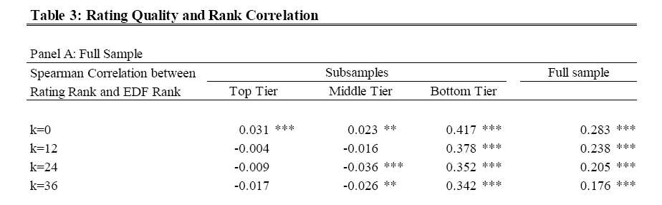
Rank correlations
Investment grades (top and middle tier) contain no information about future EDF
But Basel II and III impose steep risk weight changes
Credit Assessment | AAA to AA- | A+ to A- | BBB+ to BBB- | BB+ to B- | Below B- | unrated
Risk Weight | 20% | 50% | 100% | 100% | 150% | 100%

Slide 13
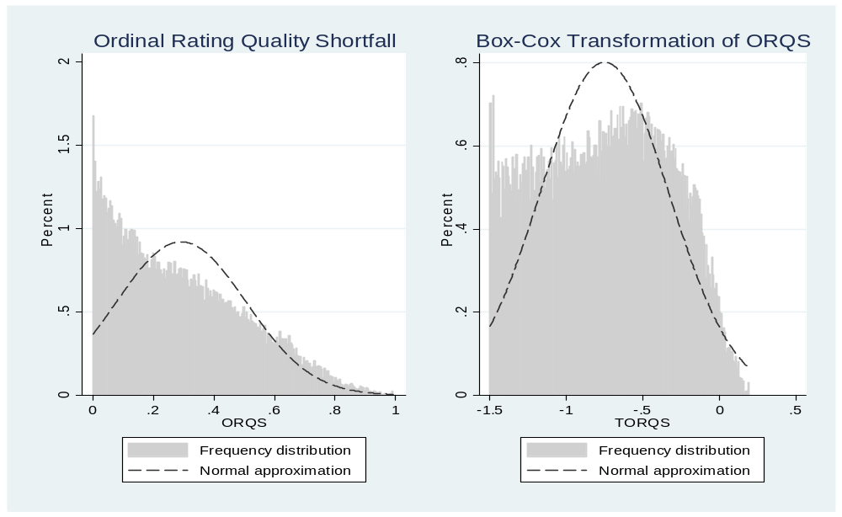
Alternative measures: TORQS and DORQS
Use Box-Cox Transform of ORQS to make data more normal: TORQS
Use directional measure of rating quality to capture rating bias:

Slide 14
Hypotheses about rating quality
H1: Different in crisis and after credit booms?
H2: Different across agencies and countries?
H3: Do conflicts of interest matter?
H4: Do bank characteristics matter?

Slide 15
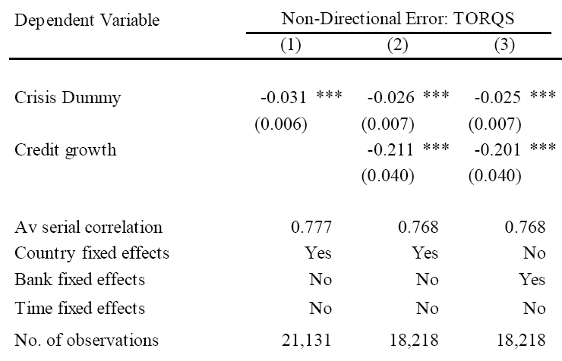
H1: Rating quality in crisis and after credit booms?
Ratings contain slightly more information (in an ordinal sense) during crisis and after strong credit growth (over the last 12 quarters); STD of TORQS = 0.43

Slide 16
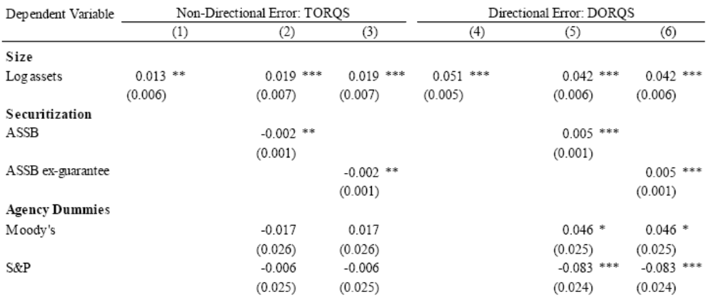
H2: Rating quality differs across agencies?
S&P ratings show less positive rating inflation

Slide 17

H3: Is there conflicts of interest?
ASSB and Size come with rating inflation!
ASSB ex guarantee ignores issuance volume with guarantees

Slide 18
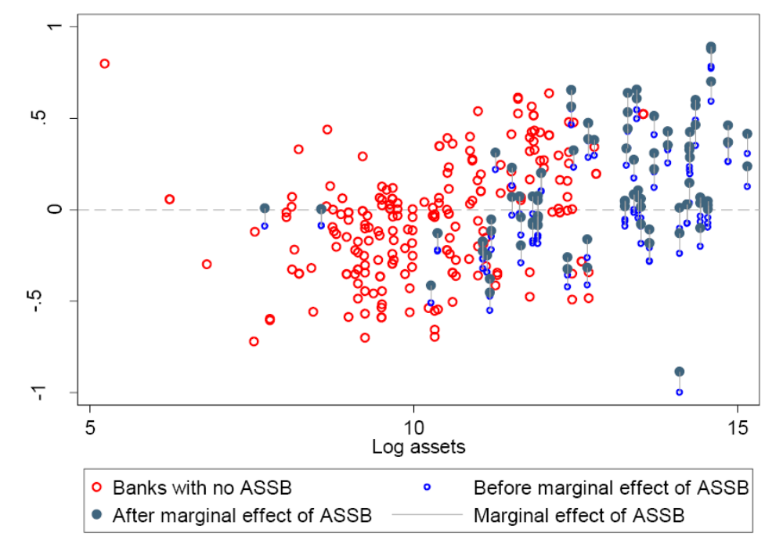
Effects of bank size and securitization business

Slide 19
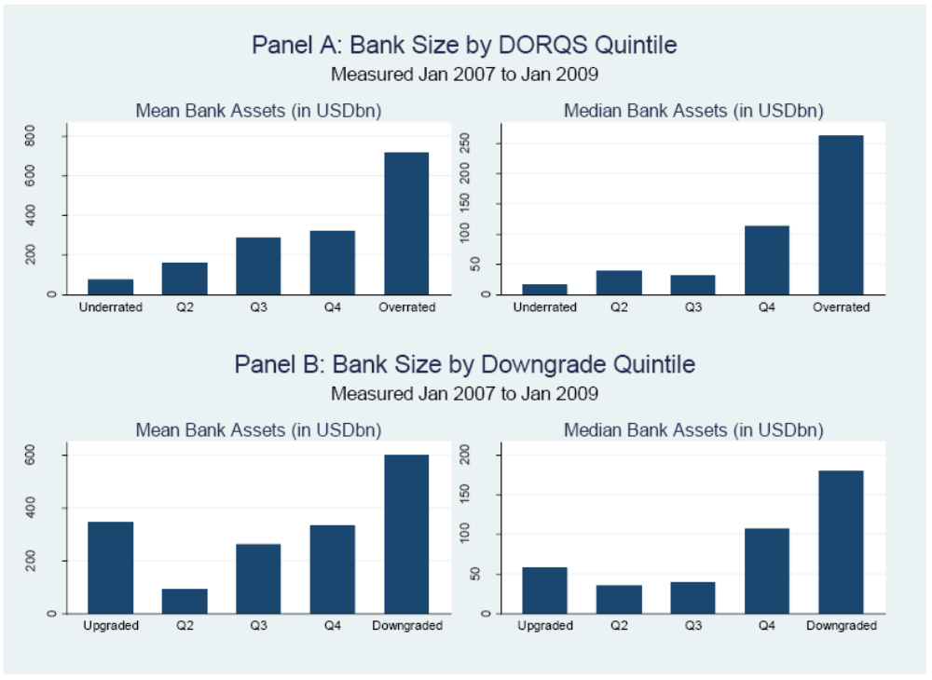
Bank Size by Rating Error and Rating Revision

Slide 20
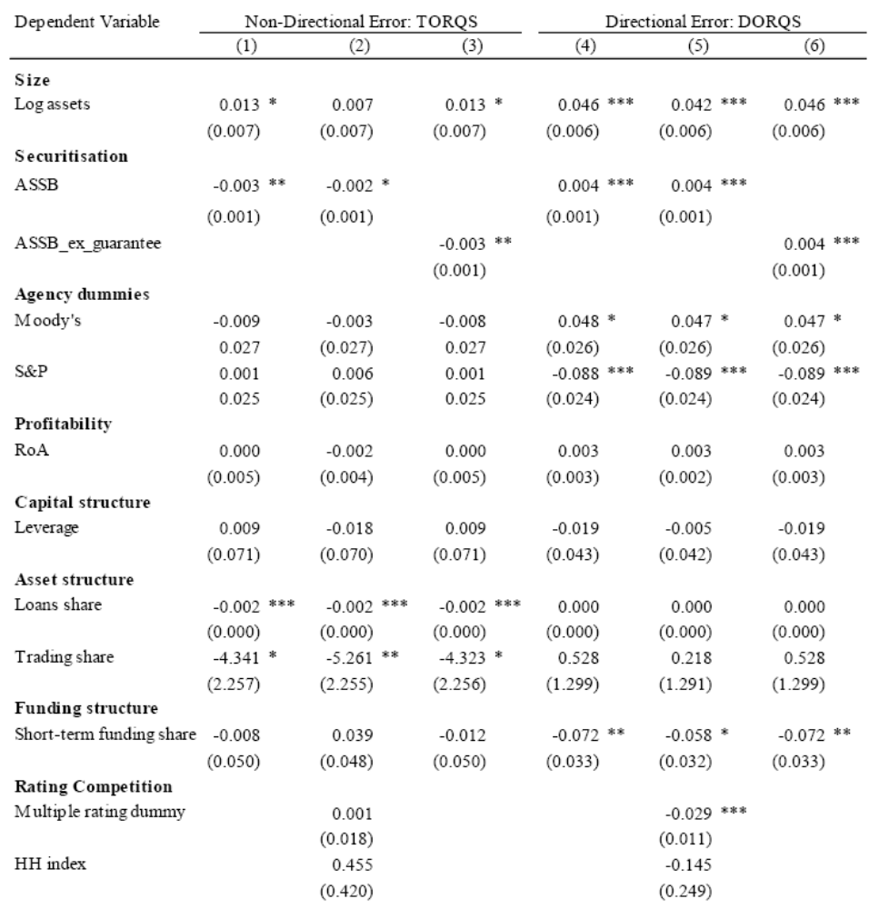
H4: Do bank characteristics matter?
Traditional banks with higher Loan share (relative to assets) have lower rating error (bank complexity matters?)
Higher trading share in revenue reduced rating error (trading revenue as a crisis hedge?)

Slide 21
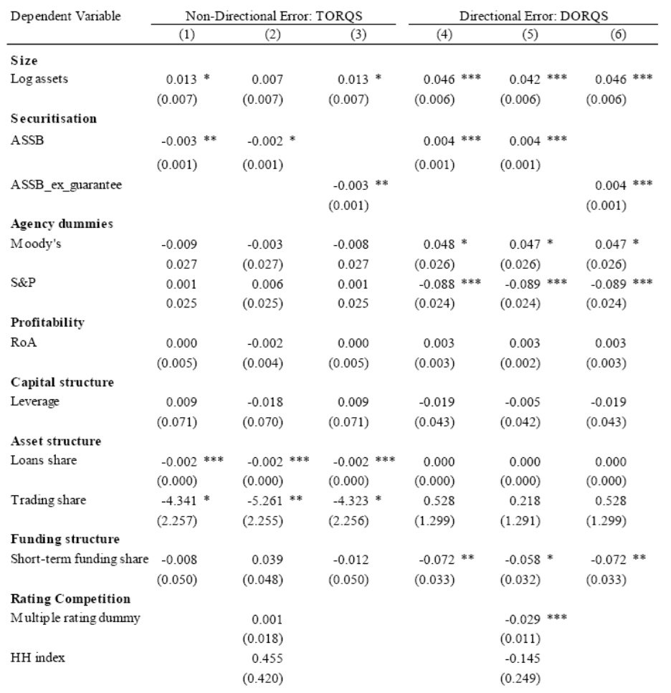
Robustness I: What role for agency competition?
Banks with Multiple Rating Dummy have systematically lower ratings
No evidence for “shopping for better ratings”

Slide 22
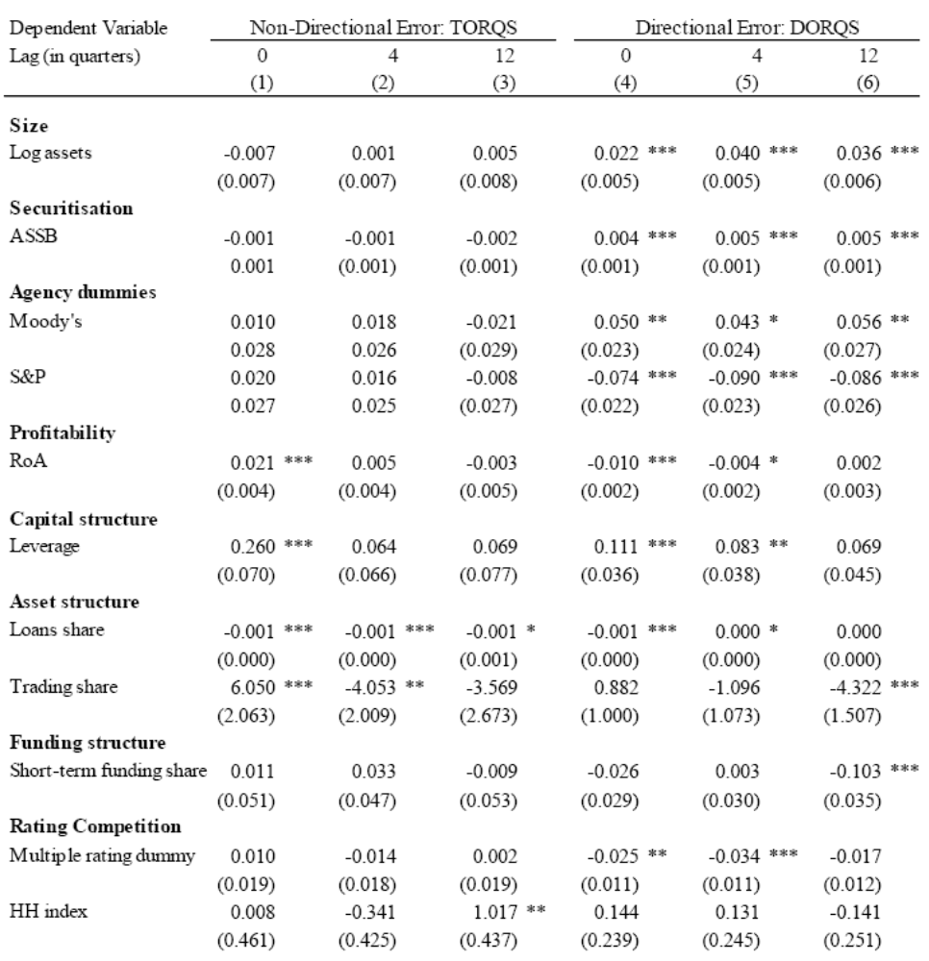
Robustness II: Lags of EDF Measurement
Similar bias for Bank Size and for ASSB at lags of 0, 4, or 12 quarters
Same agency biases
Trading share reduces bias

Slide 23
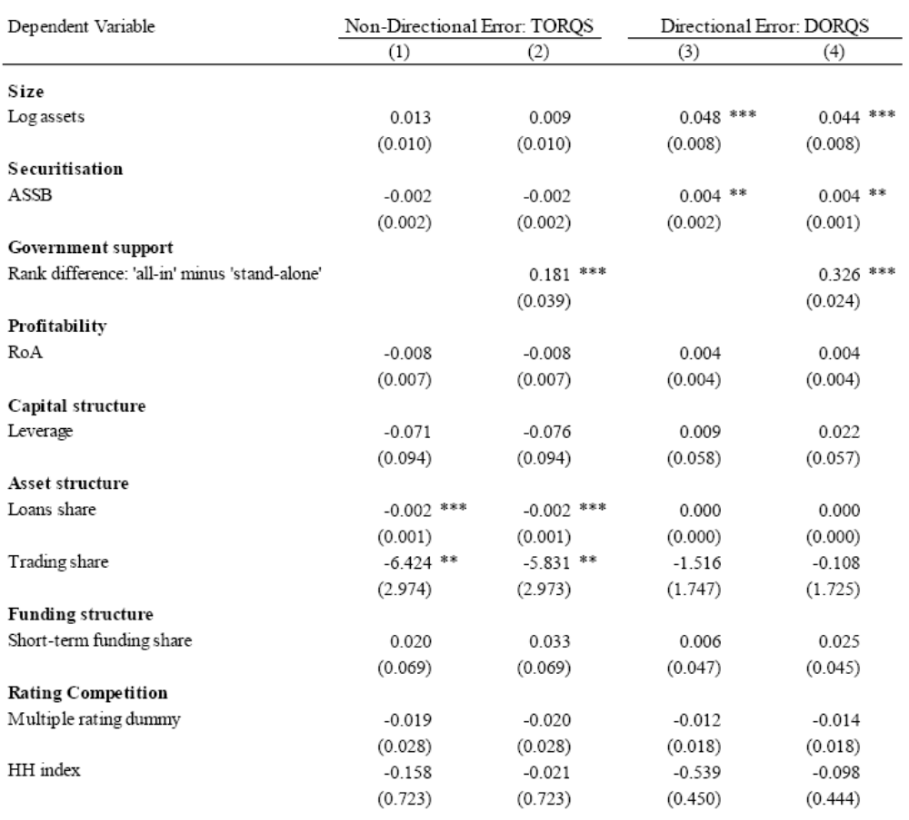
Robustness III: Controlling for Government Support
Is the size effect a “too large to fail” effect?
Examine Rank difference between “all-in” and “stand-alone” ratings available for Fitch ratings
This extra variable does not absorb the size effect

Slide 24
Main findings and policy implications
Ratings and bank regulation:
  Bank credit ratings contain very little or no information for banks with investment rating
  But Basel II and III impose steep risk weight changes across rating buckets
    This regulatory privilege has no empirical justification: it looks arbitrary and could lead to market distortions
Ratings and conflict of interest:
  Rating agencies give large banks and those providing securitization revenue better ratings
  Rating biases are a serious competitive distortion in favour of large banks; reinforcing the “too big to fail problem”
  Competition (Multiple Ratings) correlates with less favourable ratings

Slide 25
Policy implications
Rating agency reform:
  Extending Liability (Dodd-Frank act) seems have failed (SEC withdrew proposal on ABS)
  Low quality of bank ratings make it impossible to create pecuniary incentives for better ratings
  Rating paid by user unlikely to work if buy-side has additional agency problems (Calomiris, 2011, Efing 2012)
What policy to recommend?
  Improve bank disclosure; thus reduce dependence on rating agencies
  Bloechlinger, Leippold and Maire (2012) show that better ratings can be constructed based only on public data

