Slide 1
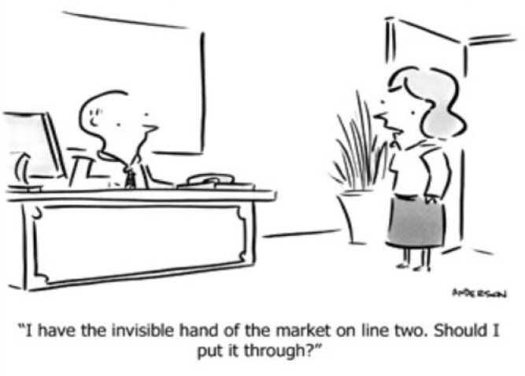
Sandy Lai
SMU http://www.sandylai-research.com
Real Effects of Stock Underpricing
Harald Hau
University of Geneva and SFI
http://www.haraldhau.com
1
Notes:
1

Slide 2
Overview
Motivation:
  What role for real investment does the stock market play?
Research method
  General identification problems and our idea
  Data and exposure measurement
  Fire sale concentration in high return stocks
Real effects of stock underpricing on investment and employment
Transmission channel: Financially constrained firms
Summary

Slide 3
Role of the Stock Market?
Stock market is a “side show”: Firm’s real investment decisions are not affected by stock market valuation (Blanchard, Summers)
“External Monitoring Tool”: Stock prices are an external monitoring tool; stock valuations condition the availability of external finance and therefore investment at least for firms dependent on external finance (Tirole)
Issues:
  Equity market listing has enormously expended relative to GDP: Why?
  How important is financial market development for investment efficiency (growth)

Slide 4
Methodological Issues I
Endogeneity Issue: Changing investment opportunities may drive both stock market value and investment?
Need a mispricing event to identify causal effect of stock pricing on investment
Problem: Markets are relatively efficient and there are few mispricing proxies which reliably identify mispricing

Slide 5
Methodological Issues II
What are ideal instruments?
  Mispricing proxy should be orthogonal to investment opportunities
    (mispricing measures in the previous literature are not)
  Mispricing proxy should be unrelated to firm characteristics
    (because firm characteristics relate to agency problems, which might also drive investment behaviour)

Slide 6
Our Idea: Mispricing due to Fund Fire Sales
2007-2008 financial crisis as experiment:
  Some equity funds had large fund losses due to portfolio holdings in bank stocks
  Large fund losses imply investor redemptions (fund outflows); exposed funds need to sell also their non-financial stocks;
  Such fire sales imply large (exogenous) under-pricing for stocks with distressed fund owners
  Can compare investment behaviour of underpriced stocks with correctly priced stocks in the same industry
Non-financial stock holdings of distressed (exposed) funds are a random treatment effect unrelated to the investment opportunities of the firm
Identification of mispricing is not based on firm characteristics, but on fund holdings

Slide 7
Our Idea: Mispricing due to Fund Fire Sales
Fund A
( exposed)
Fund B
(non-exposed)
Bank Stock
Stock 1
Stock 2
Stock 3
Procedure:
  Step 1: Measure fund exposure to financial stocks
  Step 2: Measure stock exposure in non-financials to exposed (distressed) funds

Slide 8
Data
Fund holding data (as in Hau and Lai, 2011):
  27,274 equity funds in 69 countries
  Reported holding concern approximately 30,000 stocks
  June 2007: 20,477 funds, reporting 9.7 trillion in equity assets
Focus on U.S. Stocks
  Most exposed to fire sales (because of a higher share of fund ownership)
  Ownership reporting most complete for U.S. stocks

Slide 9
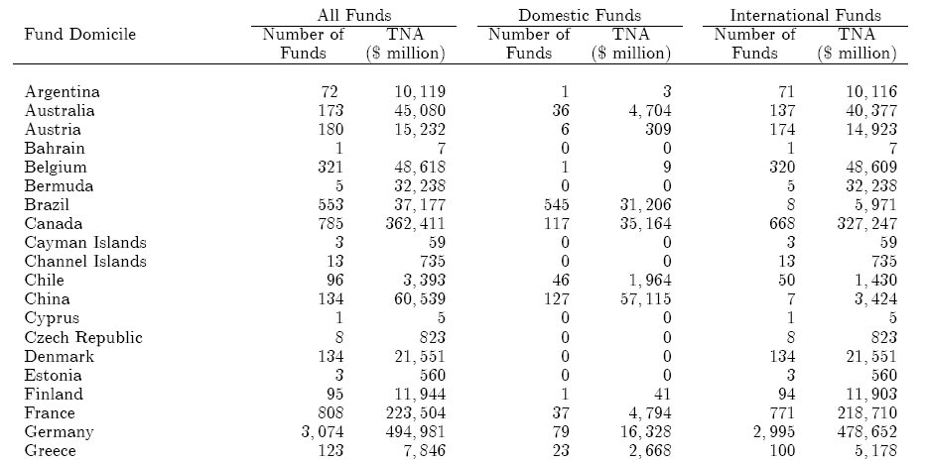
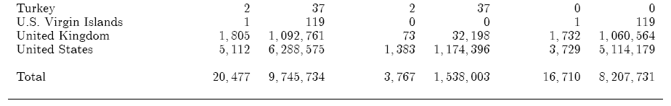
Summary Statistics
[...]
[...]

Slide 10
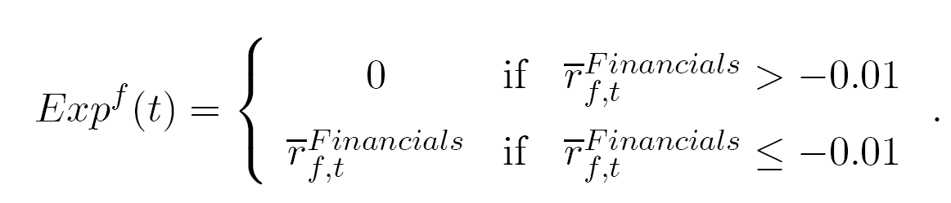
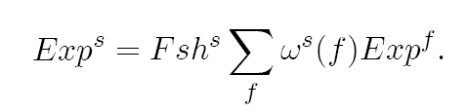
From Fund Exposure to Stock Exposure
Fund exposure: Return loss (if larger than 1%) due to financial stock investments in 2007/2 and 2008/1
Stock exposure: Aggregate fund exposure of all funds holding a stock weighted by fund ownership relative to capitalization

Slide 11
Exposed versus Non-Exposed Stocks
Define exposure dummy DExp for 33% most exposed U.S. stocks
We find that exposed stocks
  are spread over all industries
  are on average larger than non-exposed stocks
  show a drastic reduction of their fund holdings relative to non-exposed stocks
No evidence that exposed funds choose different non-financial stocks than non-exposed funds (random treatment assumption)

Slide 12
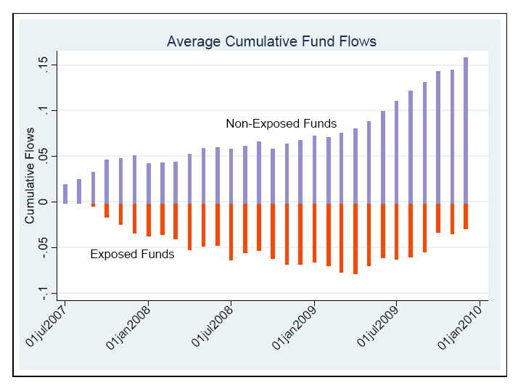
Fund Redemptions
(Exposed versus Non-Exposed funds)

Slide 13
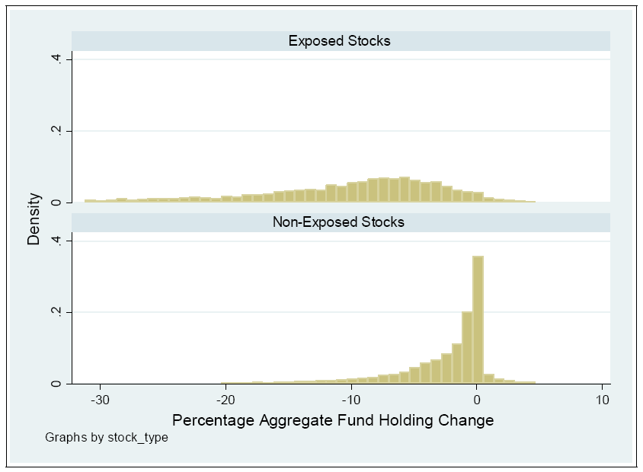
Fund Holding Changes During Crisis
(from June 2007 to June 2009)
Fire Sale Effect:
Large percentage holding reduction!

Slide 14


Price Effect of Fire Sales
Run a rolling cross-sectional quantile regressions for the cumulative (excess return) over k months based on the
  50% quantile (median performance stocks)
  75% quantile (cut-off to 25% best performing stocks)
  90% quantile (cut-off to 10% best performing stocks)
  95% quantile (cut-off to 5% best performing stocks)
Plot coefficent over different periods k

Slide 15
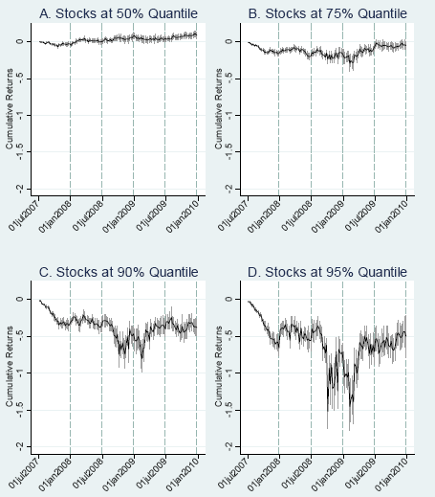
Fire Sale Discount by Stock Performance Quantile

Slide 16

Fire Sale Evidence
Fire sale discount is highly concentrated in the 50% best performing stocks
Explanations:
  Valuation uncertainty makes over-performing stocks better sells
  Disposition Effect
  Tax Effect
Implication: Use for identification of price discounts interaction of exposure dummy and high (above median) return dummy:

Slide 17
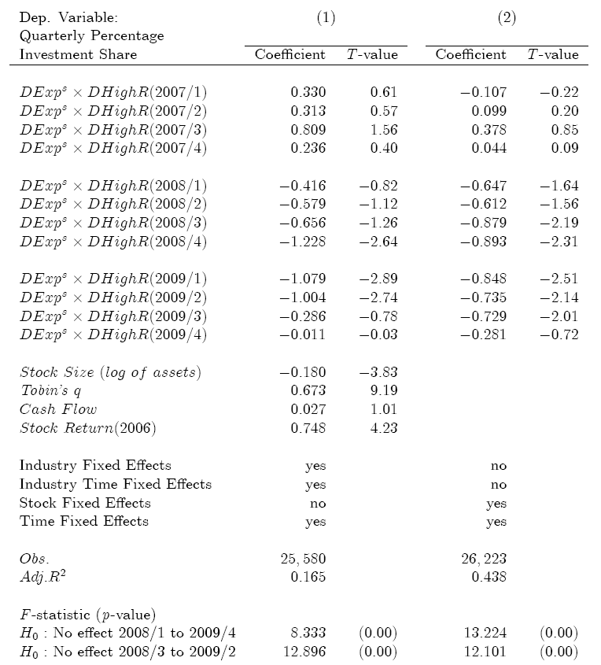
Does under-pricing have real effects?
Mean Investment
share for all stocks
in 2008/4: 6.2%
Relative Effect:
- 20%

Slide 18
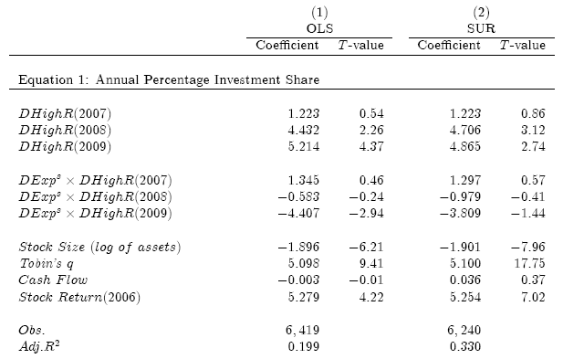

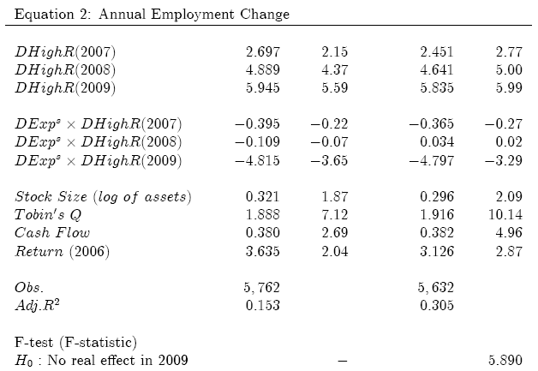
Investment and Employment Effect
Employment Effect in 2009:
- 4.8%

Slide 19
What is the Transmission Channel?
Hypothesis: Stock under-pricing should matter particularly for the financially constrained firms
How to identify financially constrained firms?
  Hadlock and Pierce (2010) examine infer financial constrains from SEC filings and test competing indices of financial constraints
  Best predictors: Age and firm size (capitalization)
Hadlock/Pierce index sort:
Top tercile: financially constrained firms
Bottom tercile: financially unconstrained firms

Slide 20
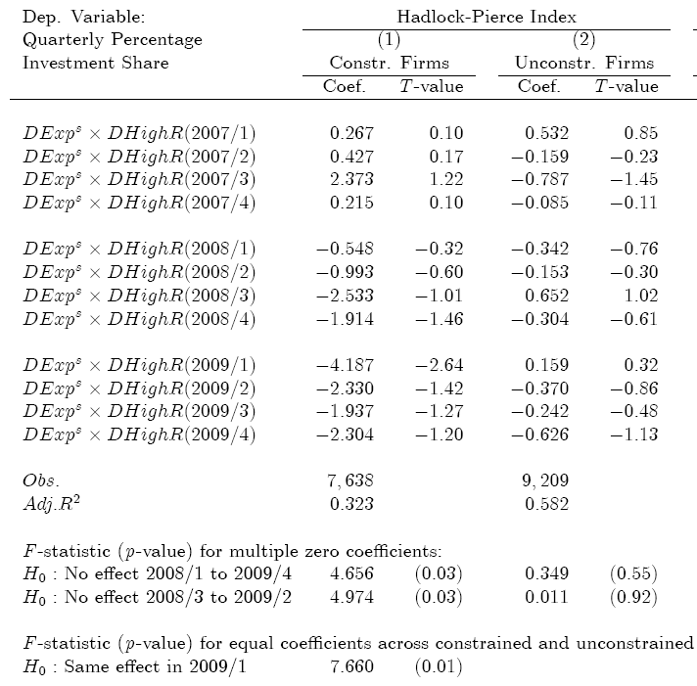
Real Effect of Under-Pricing for Constrained Firms

Slide 21
Results on Financial Constraints
For the four peak crisis quarters (2008/3 to 2009/2) we obtain among constrained firms an investment shortfall due to stock exposure of 7 percentage points (19.7% instead of 26.7%)
(= 26% investment reduction)
The investment shortfall of underpricing is concentrated in the 33% financially most constrained firms
External monitoring based on stock price matters for small and young firms

Slide 22
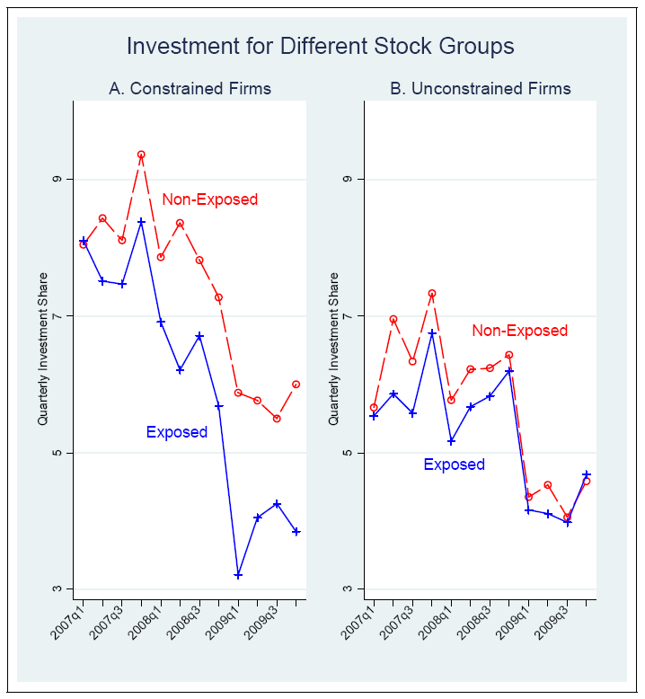

Slide 23
Summary
Our questions: What is the role of stock prices for real investments?
Have found a clean identification of exceptional (exogenous) stock underpricing
Find that stock under-pricing substantially reduces investment (and employment) among the 33% smallest and youngest firms; but not for the others

Slide 24
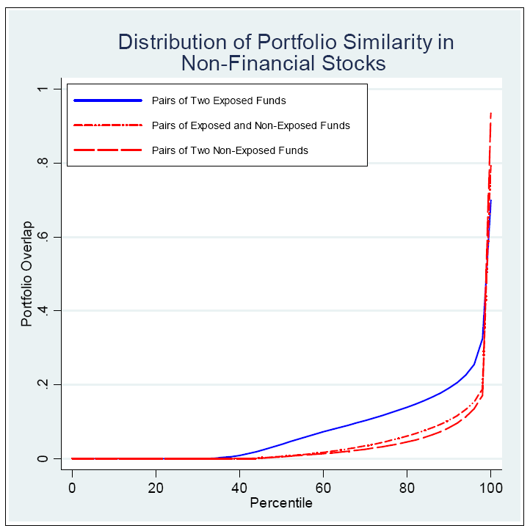
Do Exposed Funds Hold Systematically Different Stocks?

